Slide 1
Decision tree
& Random Forest
NETSOL Cohort II

Slide 2
Decision Tree
Root Nodes
Internal Node
Leaf Node
Entropy
Information gain

Slide 3
Dataset
Day | Weather | Temperature | Humidity | Wind | Play Football?
Day 1 | Sunny | Hot | High | Weak | No
Day 2 | Sunny | Hot | High | Strong | No
Day 3 | Cloudy | Hot | High | Weak | Yes
Day 4 | Rain | Mild | High | Weak | Yes
Day 5 | Rain | Cool | Normal | Weak | Yes
Day 6 | Rain | Cool | Normal | Strong | No
Day 7 | Cloudy | Cool | Normal | Strong | Yes
Day 8 | Sunny | Mild | High | Weak | No
Day 9 | Sunny | Cool | Normal | Weak | Yes
Day 10 | Rain | Mild | Normal | Weak | Yes
Day 11 | Sunny | Mild | Normal | Strong | Yes
Day 12 | Cloudy | Mild | High | Strong | Yes
Day 13 | Cloudy | Hot | Normal | Weak | Yes
Day 14 | Rain | Mild | High | Strong | No

Slide 4
Calculating Information Gain (IG) of Weather
Entropy of the entire dataset
S(+9,-5) = -(9/14) log₂(9/14) - (5/14) log₂(5/14) = 0.94
Entropy of all attribute values
S Sunny (+2,-3) = -(2/5) log₂(2/5) - (3/5) log₂(3/5) = 0.97
S Cloudy (+4,-0) = -(4/4) log₂(4/4) - (0/4) log₂(0/4) = 0
S Rain (+3,-2) = -(3/5) log₂(3/5) - (2/5) log₂(2/5) = 0.97
Information Gain
IG = S(whole data) - (5/14 × S(Sunny)) - (4/14 × S(Cloudy)) - (5/14 × S(Rain))
= 0.94 - (5/14 × 0.97) - (4/14 × 0) - (5/14 × 0.97) = 0.247

Slide 5
IG Weather = 0.247 (Root Node)
IG Temperature = 0.029
IG Humidity = 0.153
IG Wind = 0.047
IG (sunny, temp) = 0.57
IG (sunny, humidity) = 0.97
IG (sunny, wind) = 0.019
Day | Weather | Temp | Humidity | Wind | Play
1 | Sunny | Hot | High | Weak | No
2 | Sunny | Hot | High | Strong | No
8 | Sunny | Mild | High | Weak | No
9 | Sunny | Cool | Normal | Weak | Yes
11 | sunny | Mild | normal | strong | Yes
IG (rain, temp) = 0.019
IG (rain, humidity) = 0.019
IG (rain, wind) = 0.97

Slide 6
Weather
Sunny
Cloudy
Rain
humidity
Yes
high
low
Strong
Weak
No
Yes
No
Yes

Slide 7
Random Forest is an ensemble learning algorithm that combines multiple Decision Trees to make a more reliable prediction.
Bootstrap Sampling – Create different random samples from the original dataset.
Build Multiple Trees – Train a Decision Tree on each sample.
Random Feature Selection – At each split, each tree considers a random subset of features.
Combine Predictions
  Classification: Majority voting
  Regression: Average of predictions
flow:
Dataset → Random Samples → Multiple Decision Trees → Voting/Averaging → Final Prediction

Slide 8
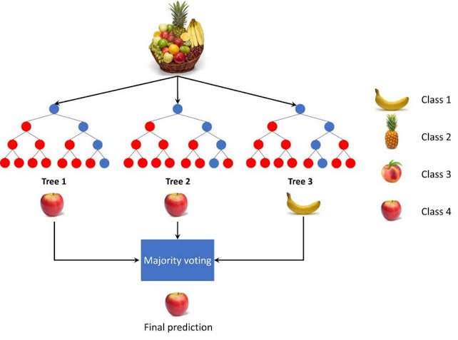
Ensemble Learning

Slide 9
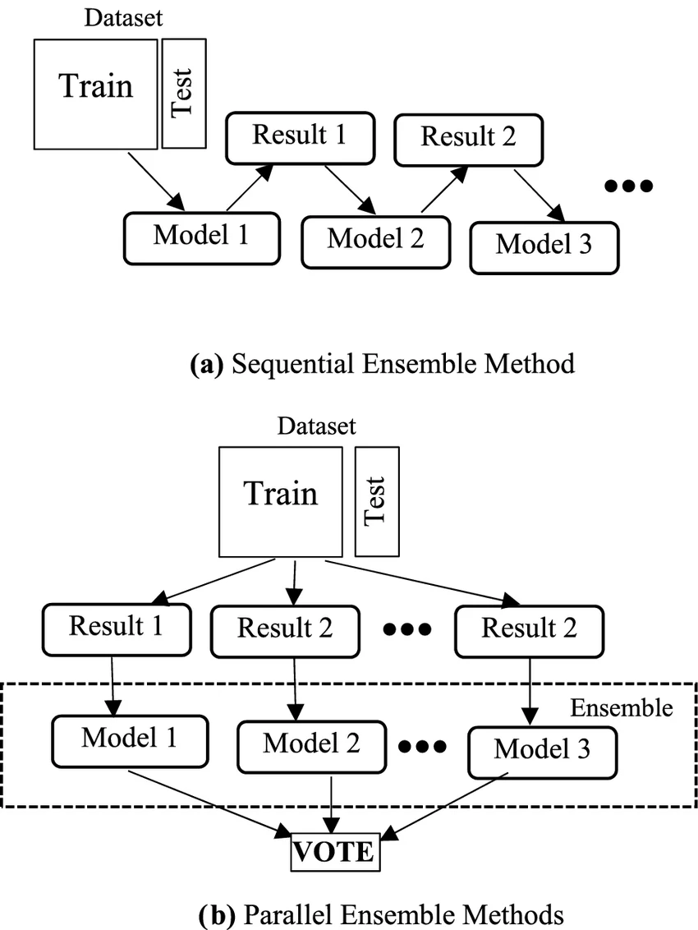
Ensemble Learning
Sequential Ensembling
Parallel Ensembling

Slide 10
Parameter | Meaning
n_estimators | Number of decision trees
max_depth | Maximum depth of each tree
max_features | Number of features considered for each split
random_state | Ensures reproducible results
bootstrap | Uses random sampling with replacement; default is True

Slide 11
Advantages
Reduces overfitting compared with a single Decision Tree.
Usually provides better generalization.
Works for both classification and regression.
Can handle many features and large datasets.
Provides feature importance.
Disadvantages
More computationally expensive than one Decision Tree.
Less interpretable because many trees are involved.
Prediction can be slower with a very large number of trees.

Slide 12
